Slide 1
Capstone Project: Grouping the world’s most populous Metropolitan cities
G.Mukkesh
June 1st, 2019

Slide 2
Introduction / Business Problem
With the advent of technology, the world has now become a global village. People living in different metropolitan cities of the world are being exposed to the cultures of various nations in the forms of movies, books, tv shows and restaurants, and are able to experience them without actually visiting the country.
The purpose of this study is to use the FourSquare location data to group different metropolitan cities into clusters, depending on how similar/dissimilar they are to each other. By doing so, we will be able to find out the cities which offer a similar lifestyle in terms of the amenities present.

Slide 3
Data
The 100 most populous metropolitan cities of the world were scraped from Wikipedia (https://en.wikipedia.org/wiki/List_of_metropolitan_areas_by_population).
Using the geocoder module in python, we get the latitudes and longitudes of the 100 cities need to be found.
Feeding these coordinates into the FourSquare API, we can get the top 100 venues for the cities, along with the venue’s longitudes, latitudes and venue category
After getting the top 10 locations for every city, we can get the set of unique venue categories and then one-hot-vector encode them, after grouping all the venues by their city to get the frequency of occurrence .

Slide 4
Methodology
Web scraping was carried out using Python’s beautifulsoup package to gather the list of top 100 most populous metropolitan cities in the world
The GeoCoder package was used to get the co-ordinates of the scraped cities.
Foursquare API was used to get additional information needed for the analysis. Data wrangling was performed to clean and transform the data, and it was loaded into a pandas frame.
Folium package was used to visualize the locations on a map.
K-Means++ Clustering Algorithm was applied on the data set to cluster the cities and inferences were made from it.

Slide 5
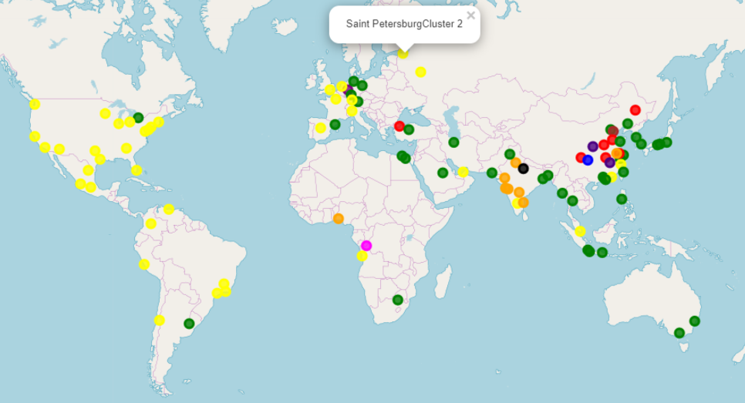
Results
10 clusters were created and the cities were assigned to them accordingly.
Even though the clusters had some cities in them which made it look erroneous , further exploration proved that the clusters were, indeed consistent with their results.
Due to this, hidden connections between different cities of the world were unearthed.

Slide 6
Conclusion
The K-Means ++ algorithm was used to cluster these cities depending on how similar they were to one another.
By analysing the cities present in the different clusters, I was able to find out probable reasons to why they might fall under the same cluster, even though it seemingly looked as if they no connections to each other in the first place.
Using these observations, one can find out whether the new city that he/she is moving to has a lifestyle which is similar or dissimilar to the one that he/she is currently residing in.

